Slide 1

Department of Computer Engineering & Applications, Institute of Engineering & Technology
Welcome To GLOOM

Slide 2
Industrial Training project (2020-21)
GLOOM

Slide 3

Contents
Abstract
Introduction
Objective
Motivation
Technologies Used
Implementation and user interface
Conclusion

Slide 4
Abstract
The project is aimed to learn basics of game development with Unity. Through hands on, practical experience, we go through concepts like creating a game loop, image display and transformation, event handling, and writing game logic. We then apply the concepts to create our first game with Unity. This project is aimed to get started with game development using unity.

Slide 5
Introduction
The video games industry has been booming with unprecedented growth in revenue for the past 5 years or so. And hence, the demand for new and unique games is high. So to make my first steps in gaming programming, Gloom is made.
Unity is used to built this fun game to make initial steps to learn game development with unity.
Gloom game is a type of game where the player manipulates direction of player to complete all level and complete it

Slide 6
Objective
The objective of this project is to make a casual gaming apps and to understand the concept of unity which can be further extended to create professional level multiplayer games.

Slide 7
Motivation
In this cut-throat competition, game development is one of those fields that is experiencing a great demand . It has gained a lot of scope in the top-notch industries. Therefore, being a Computer Science student, it becomes quite necessary to learn the latest technologies in order to increase one’s career prospects. And hence, the demand for new and unique games is high. So to make my first steps in gaming, Gloom

Slide 8
Technologies Used
Unity
Photoshop
Microsoft visual studio

Slide 9
Unity
Unity is a cross-platform game engine developed by Unity Technologies, first announced and released in June 2005 at Apple Inc.’s
It is an engine which help us to make games with predefine assets.

Slide 10
Adobe Photoshop
Adobe Photoshop is a raster graphics editor developed and published by Adobe Inc. for Windows and macOS.
It is a computer program that allows you to make changes to image or to create image.
From photo editing and compositing to digital painting, animation and graphic design — you can do it all in Photoshop.

Slide 11
Microsoft visual studio
Microsoft visual studio is an integrated development environment (IDE) from Microsoft. It is used to develop computer programs, as well as websites, web apps, web services and mobile apps.

Slide 12
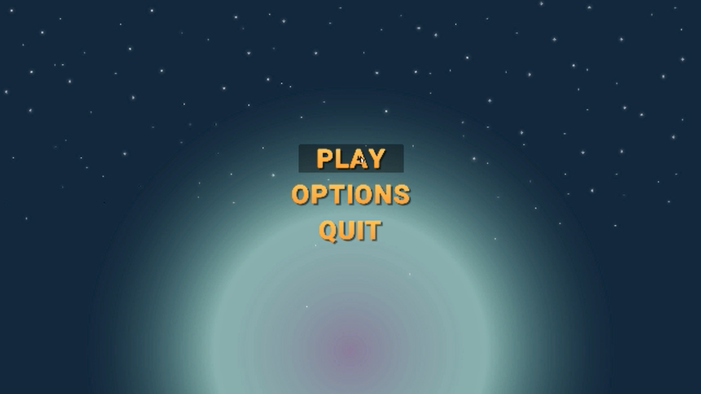

Slide 13
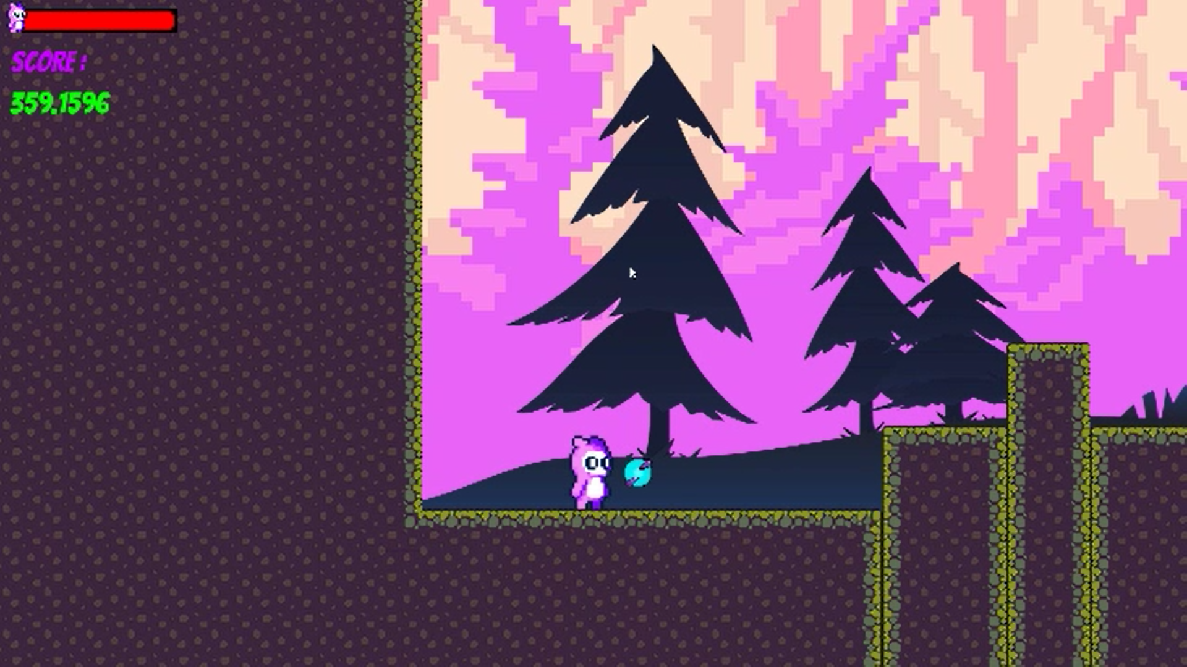

Slide 14
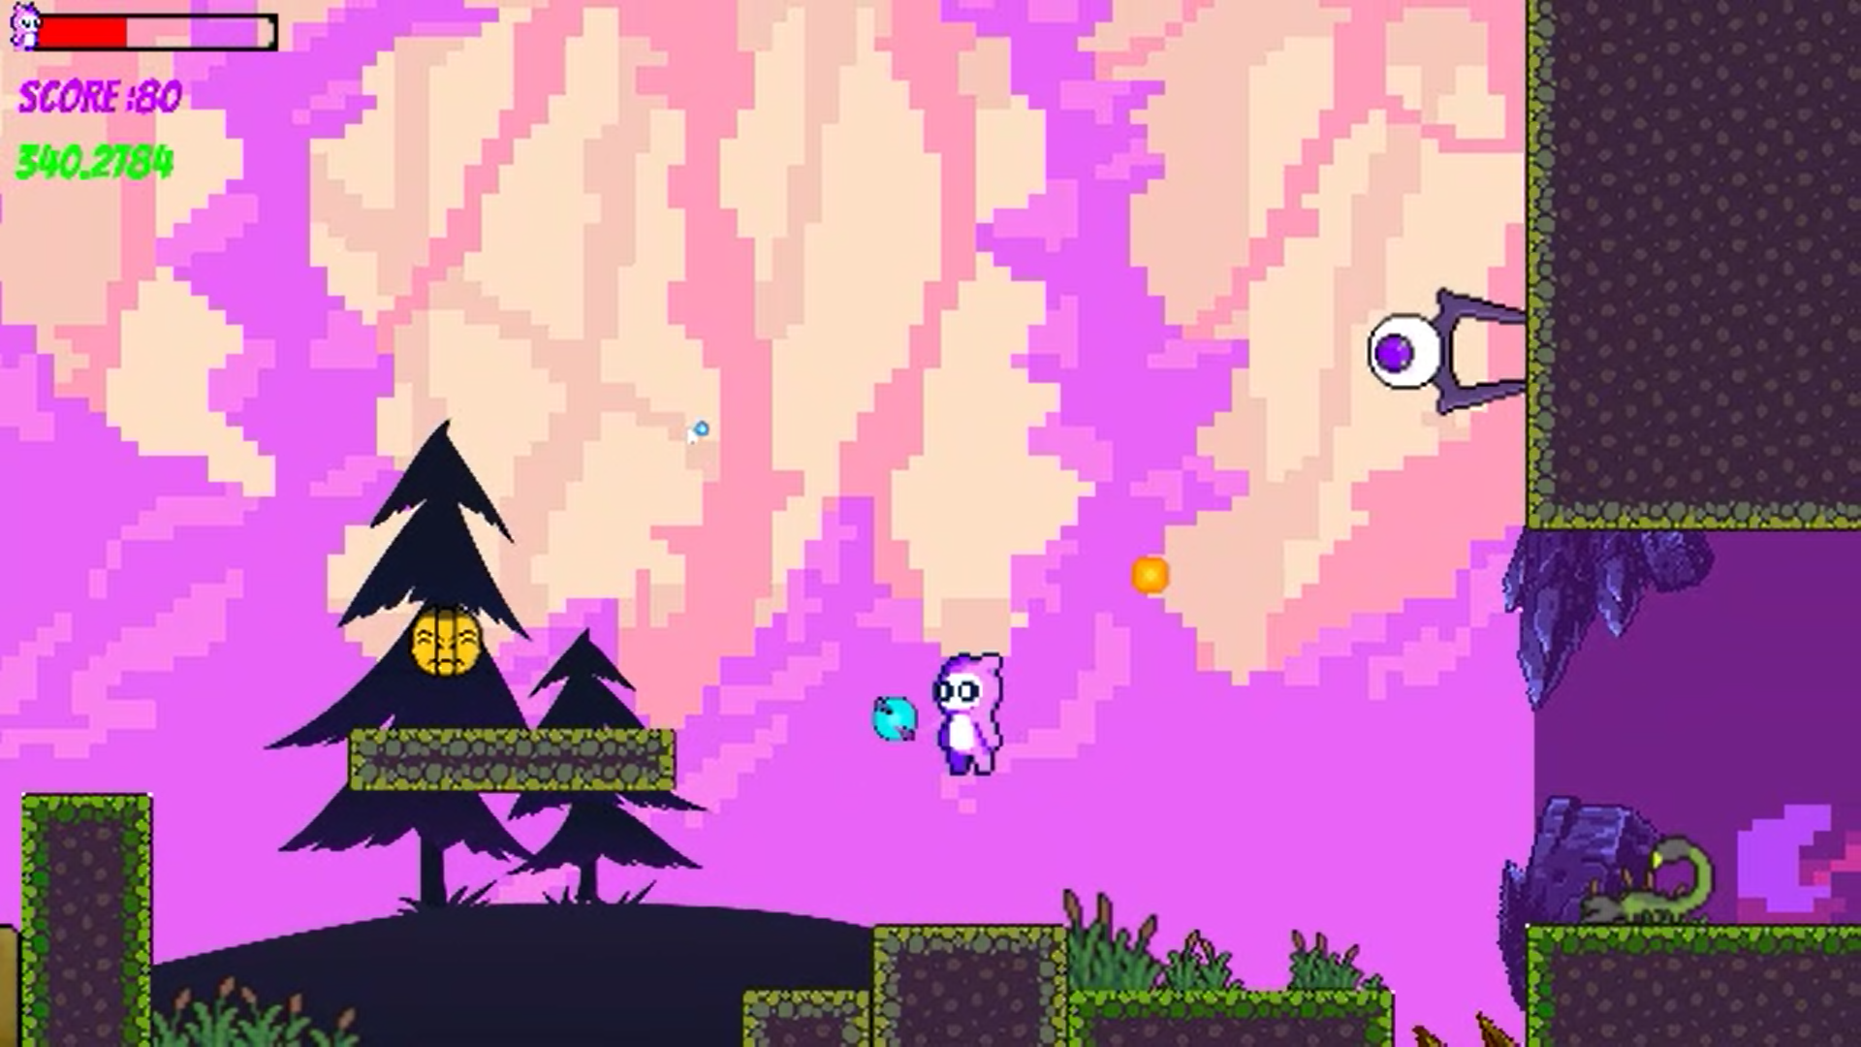

Slide 15
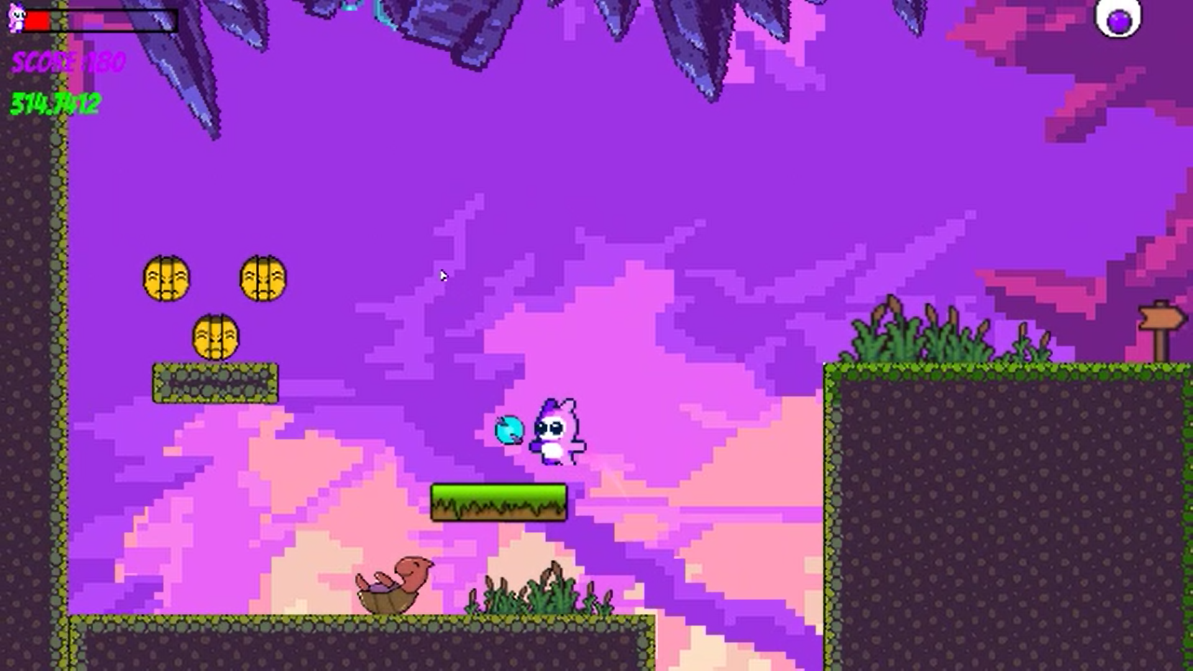

Slide 16
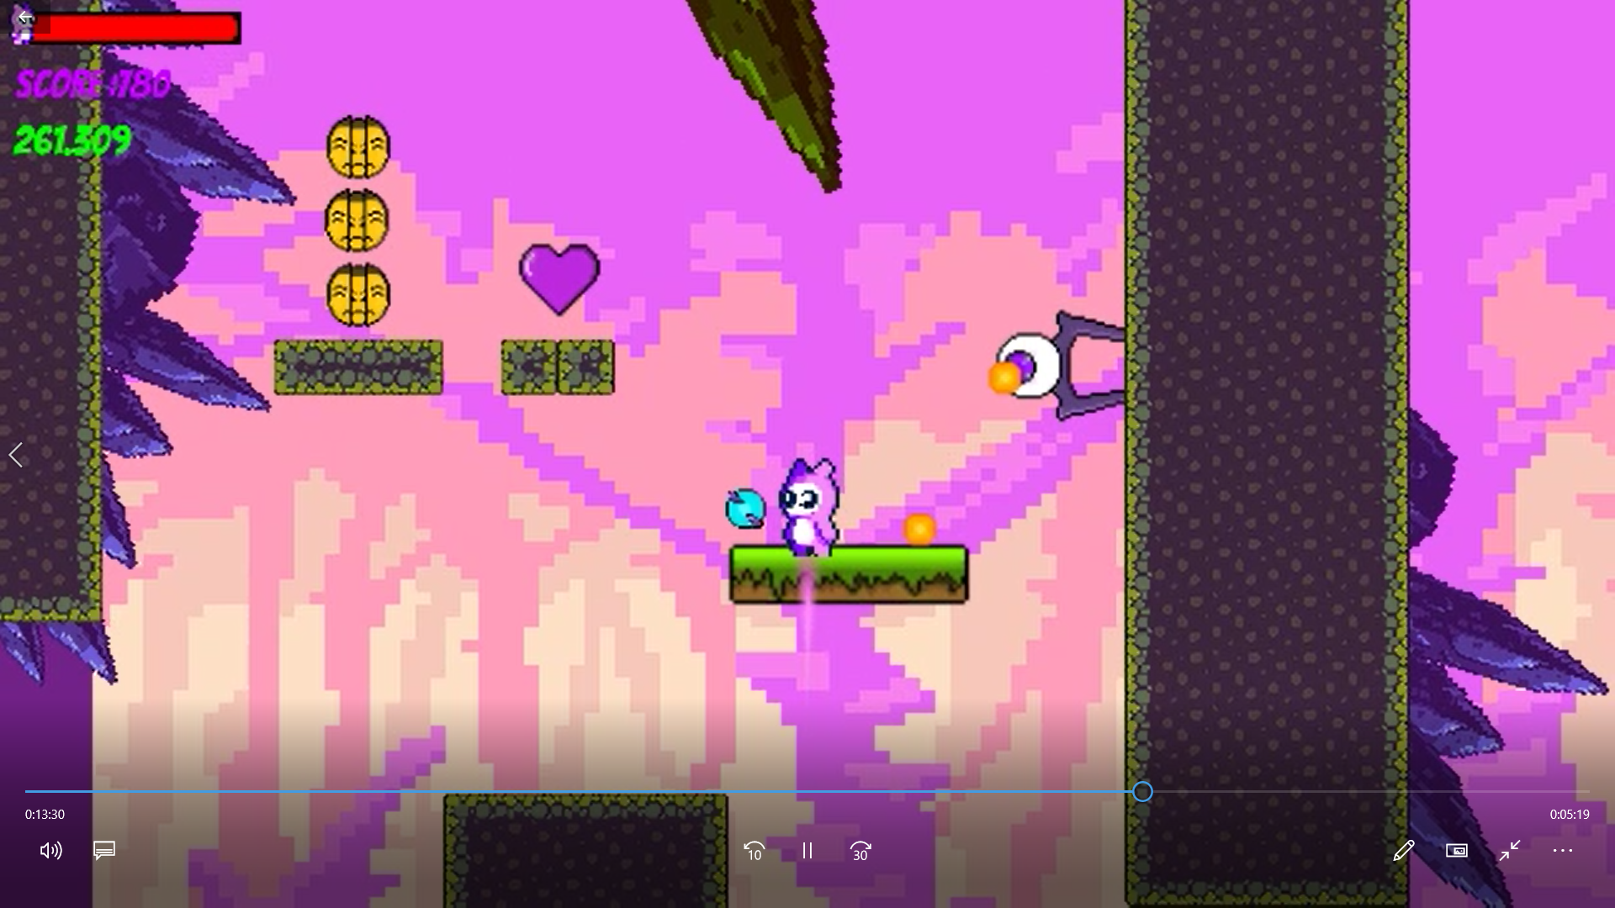

Slide 17
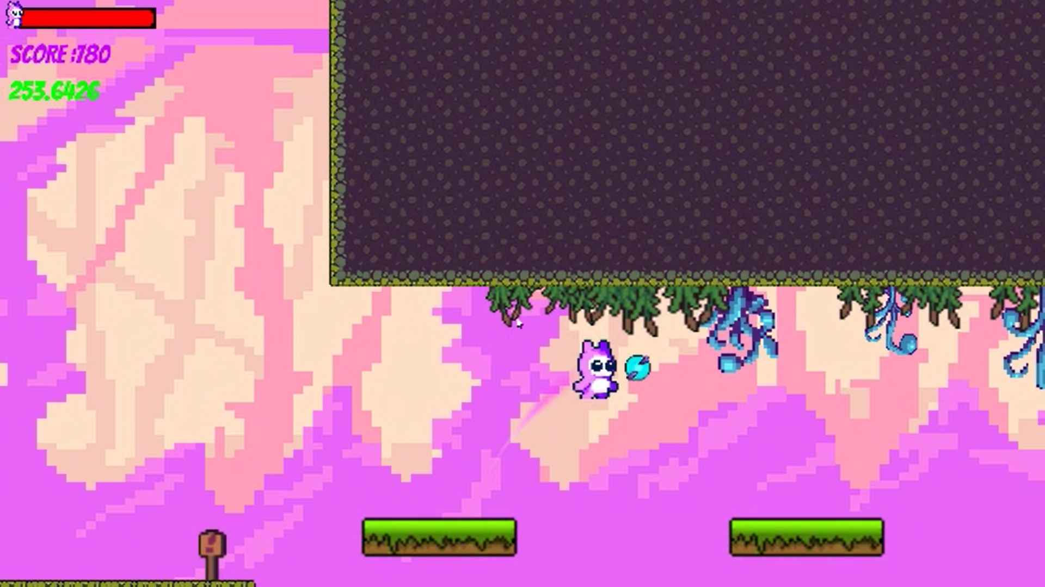

Slide 18
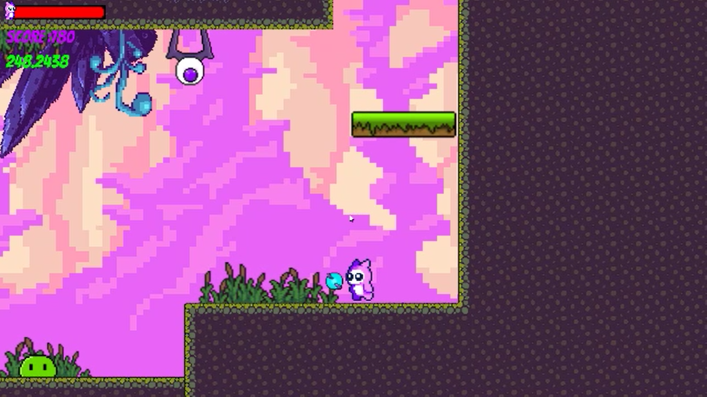

Slide 19
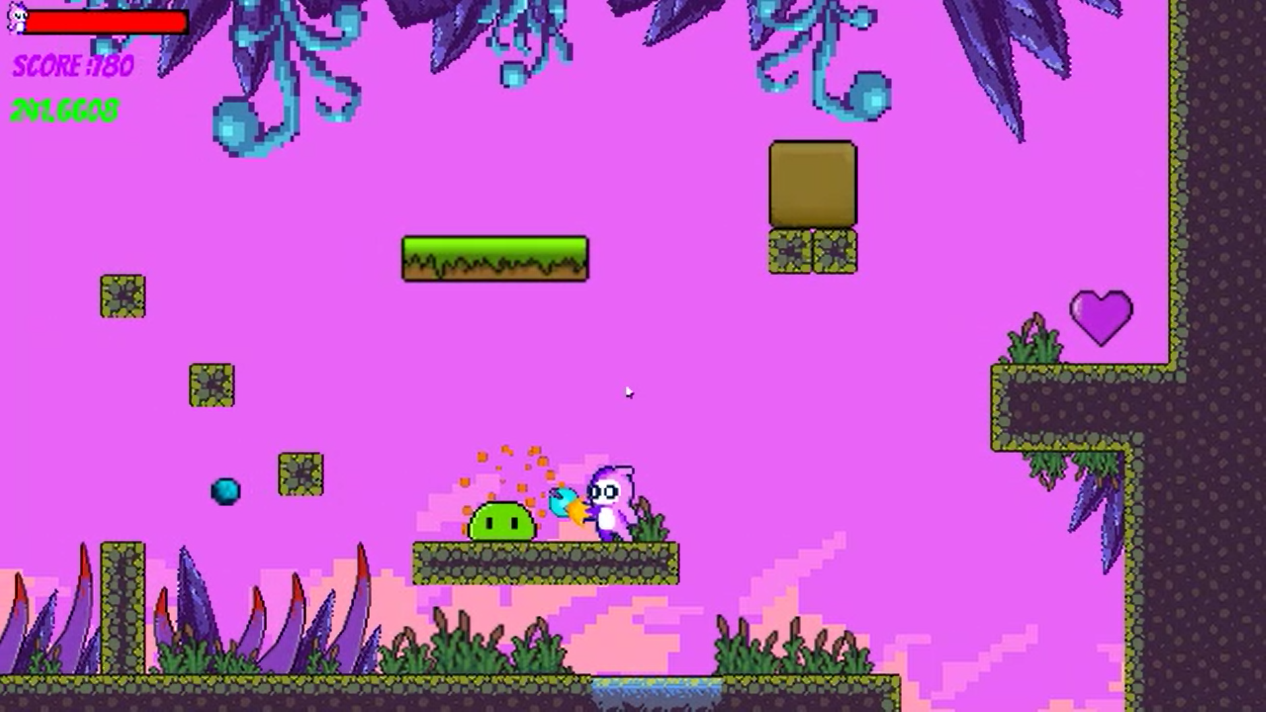

Slide 20
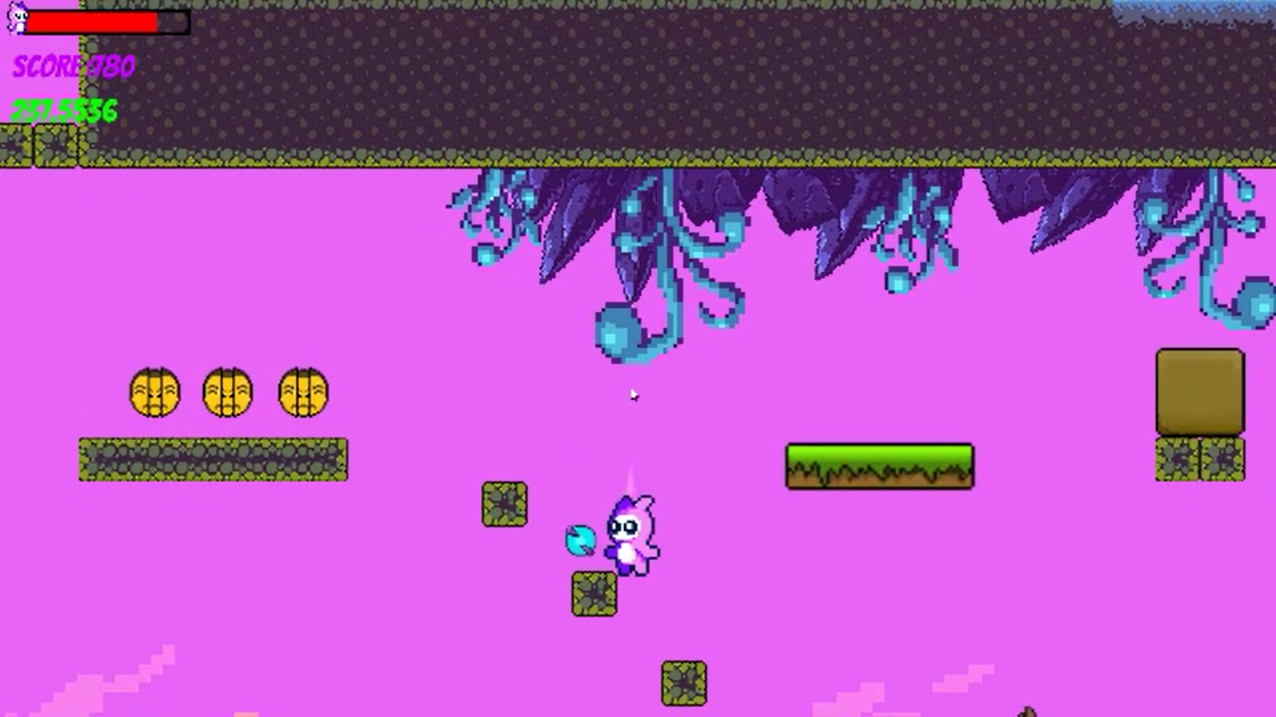

Slide 21
Conclusion
From proper analysis and constraints, it can be concluded that this game project is efficient to run on every operating system. Also, the game “Gloom” is user friendly and can be a relaxing game to play. And this marks a great step towards start of the learning of game development.

Slide 22
Thank you

